Slide 1
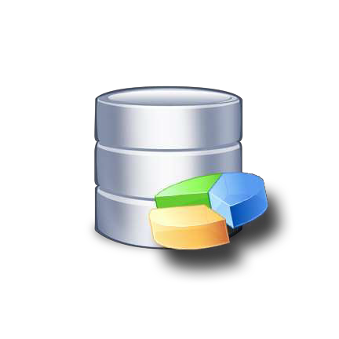
Data Warehouse
Definition :
A data warehouse is a subject-oriented, integrated, time-variant and non-volatile collection of data in support of management's decision making process.
prepared by : Aashish Rathod

Slide 2
Explanation :
Subject-Oriented: A data warehouse can be used to analyze a particular subject area. For example, "sales" can be a particular subject.
Integrated: A data warehouse integrates data from multiple data sources. For example, source A and source B may have different ways of identifying a product, but in a data warehouse, there will be only a single way of identifying a product.
prepared by : Aashish Rathod

Slide 3
Time-Variant: Historical data is kept in a data warehouse. For example, one can retrieve data from 3 months, 6 months, 12 months, or even older data from a data warehouse. This contrasts with a transactions system, where often only the most recent data is kept. For example, a transaction system may hold the most recent address of a customer, where a data warehouse can hold all addresses associated with a customer.
prepared by : Aashish Rathod
Non-volatile: Once data is in the data warehouse, it will not change. So, historical data in a data warehouse should never be altered.

Slide 4
Benefits of a Data Warehouse
A Data Warehouse Delivers Enhanced
Business Intelligence
By providing data from various sources, managers and executives will no longer need to make business decisions based on limited data or their gut. In addition, “data warehouses and related BI can be applied directly to business processes including marketing segmentation, inventory management, financial management, and sales.”
prepared by : Aashish Rathod

Slide 5
A Data Warehouse Saves Time
Since business users can quickly access critical data from a number of sources—all in one place—they can rapidly make informed decisions on key initiatives.
A Data Warehouse Enhances Data Quality
and Consistency
prepared by : Aashish Rathod
A data warehouse implementation includes the conversion of data from numerous source systems into a common format. Since each data from the various departments is standardized, each department will produce results that are in line with all the other departments.
6

Slide 6
A Data Warehouse Provides Historical Intelligence
A data warehouse stores large amounts of historical data so you can analyze different time periods and trends in order to make future predictions. Such data typically cannot be stored in a transactional database or used to generate reports from a transactional system.
A Data Warehouse Generates a High ROI
prepared by : Aashish Rathod
Finally, the piece de resistance—return on investment. Companies that have implemented data warehouses and complementary BI systems have generated more revenue and saved more money than companies that haven’t invested in BI systems and data warehouses.
7

Slide 7
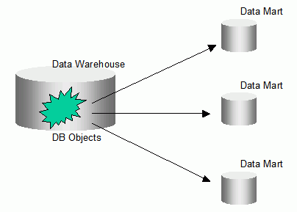
Data Mart
Definition :
A data mart is a simple form of a data warehouse that is focused on a single subject (or functional area), such as Sales, Finance, or Marketing. Data marts are often built and controlled by a single department within an organization.
prepared by : Aashish Rathod
8

Slide 8
Differences Between
a Data Warehouse and a Data Mart
Category Data Warehouse Data Mart
prepared by : Aashish Rathod
• •
•
Scope Corporate
Line of Business (LOB)
Single subject
Few
< 100 GB
Months
•
•
•
•
Subject
Data Sources
Size (typical)
•
•
•
Multiple
Many
100 GB-TB+
Months to years
•
•
•
•
Implementation •
Time
9

Slide 9
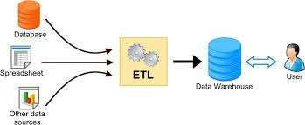
ETL(Extract Transform and Load)
Definition :
ETL stands for extract, transform, load, three database functions that are combined into one tool to pull data out of one database and place it into another database.
prepared by : Aashish Rathod

Slide 10
Explanation :
Extract means to get data from source
system as efficiently as possible.
Source system can RDBMS and files
In this data is extracted from source system
The main objective of this step is retrieve all required data from the source system
prepared by : Aashish Rathod

Slide 11
Transform:
This step include the cleaning ,filtering ,validating and applying rules to extracted data.
The main objective of this step is to load the extracted data into targeted database with clean and general format.
This is because we extracted data from various sources and each have their own format.
For example there are two sources A and B.
A date format is dd/mm/yyyy.
B date format is yyyy/mm/dd
In transformation these date are being into general format.

Slide 12
Other thing that are carried out in this steps are:
Cleaning : (male to M and female to F)
Filtering : (selecting only certain column to load)
Enrichment : (Full name to ‘First name’,’middle name’,’last name’)
Splitting : Splitting one column into multiple column
Joining: together data from multiple souces

Slide 13
Loading:
Data is extracted and transform is of no use until it is loaded in target database.
In this step the extracted data transform data is loaded into targeted databse.
In order to make data load efficiently it is necessary to index the database.

